Slide 1
So there’s this monkey in a tree…
A monkey is perched up in a tall tree. A zookeeper wants to give the monkey a banana, but the monkey refuses to come down. The zookeeper has a slingshot with which to fling a banana up to the monkey. Where should the zookeeper aim if…
The monkey stays perched in the tall tree?
The monkey lets go at the exact same moment the banana is released (think about this one!)

Slide 2
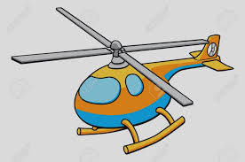
Another brain teaser
A helicopter carrying supplies for some hikers stuck in remote backcountry flies level at a constant rate of 75 m/s at an altitude of 350 m. It needs to release the supplies so they free fall to the hikers’ location. Where/when should they release the supplies so they land at the target? Neglect air resistance. Sketch the path of the supplies once they’re released from the helicopter.
75 m/s

Slide 3
Projectile problems du jour
3.27: A person finds a soccer ball in a field and needs to kick it back over the fence, which is 36 m away. The fence is 3.05 m height. The person kicks the ball from ground level with a speed of 20.0 m/s at an angle of 53º above the horizontal. (a) By how much does the ball clear or fall short of the top of the fence? (b) Does the ball approach the fence top while still rising or while falling?
3.32: Water leaves a hose at 50. m/s at an angle of 30º above the horizontal. How high up on a wall 50.0 m away will the water strike?
3.58: A 2.00-m tall basketball player is standing on the floor 10.0 m from the basket. If he shoots the ball at a 40.0 degree angle above the horizontal, at what initial speed must be throw the ball so it goes through the hoop without striking the backboard? The height of the basket is 3.05 m.

